Slide 1
Hello Class 1.
I hope you enjoy joining in with the dinosaur counting book.
Remember to look closely to find the dinosaur on each page!

Slide 2
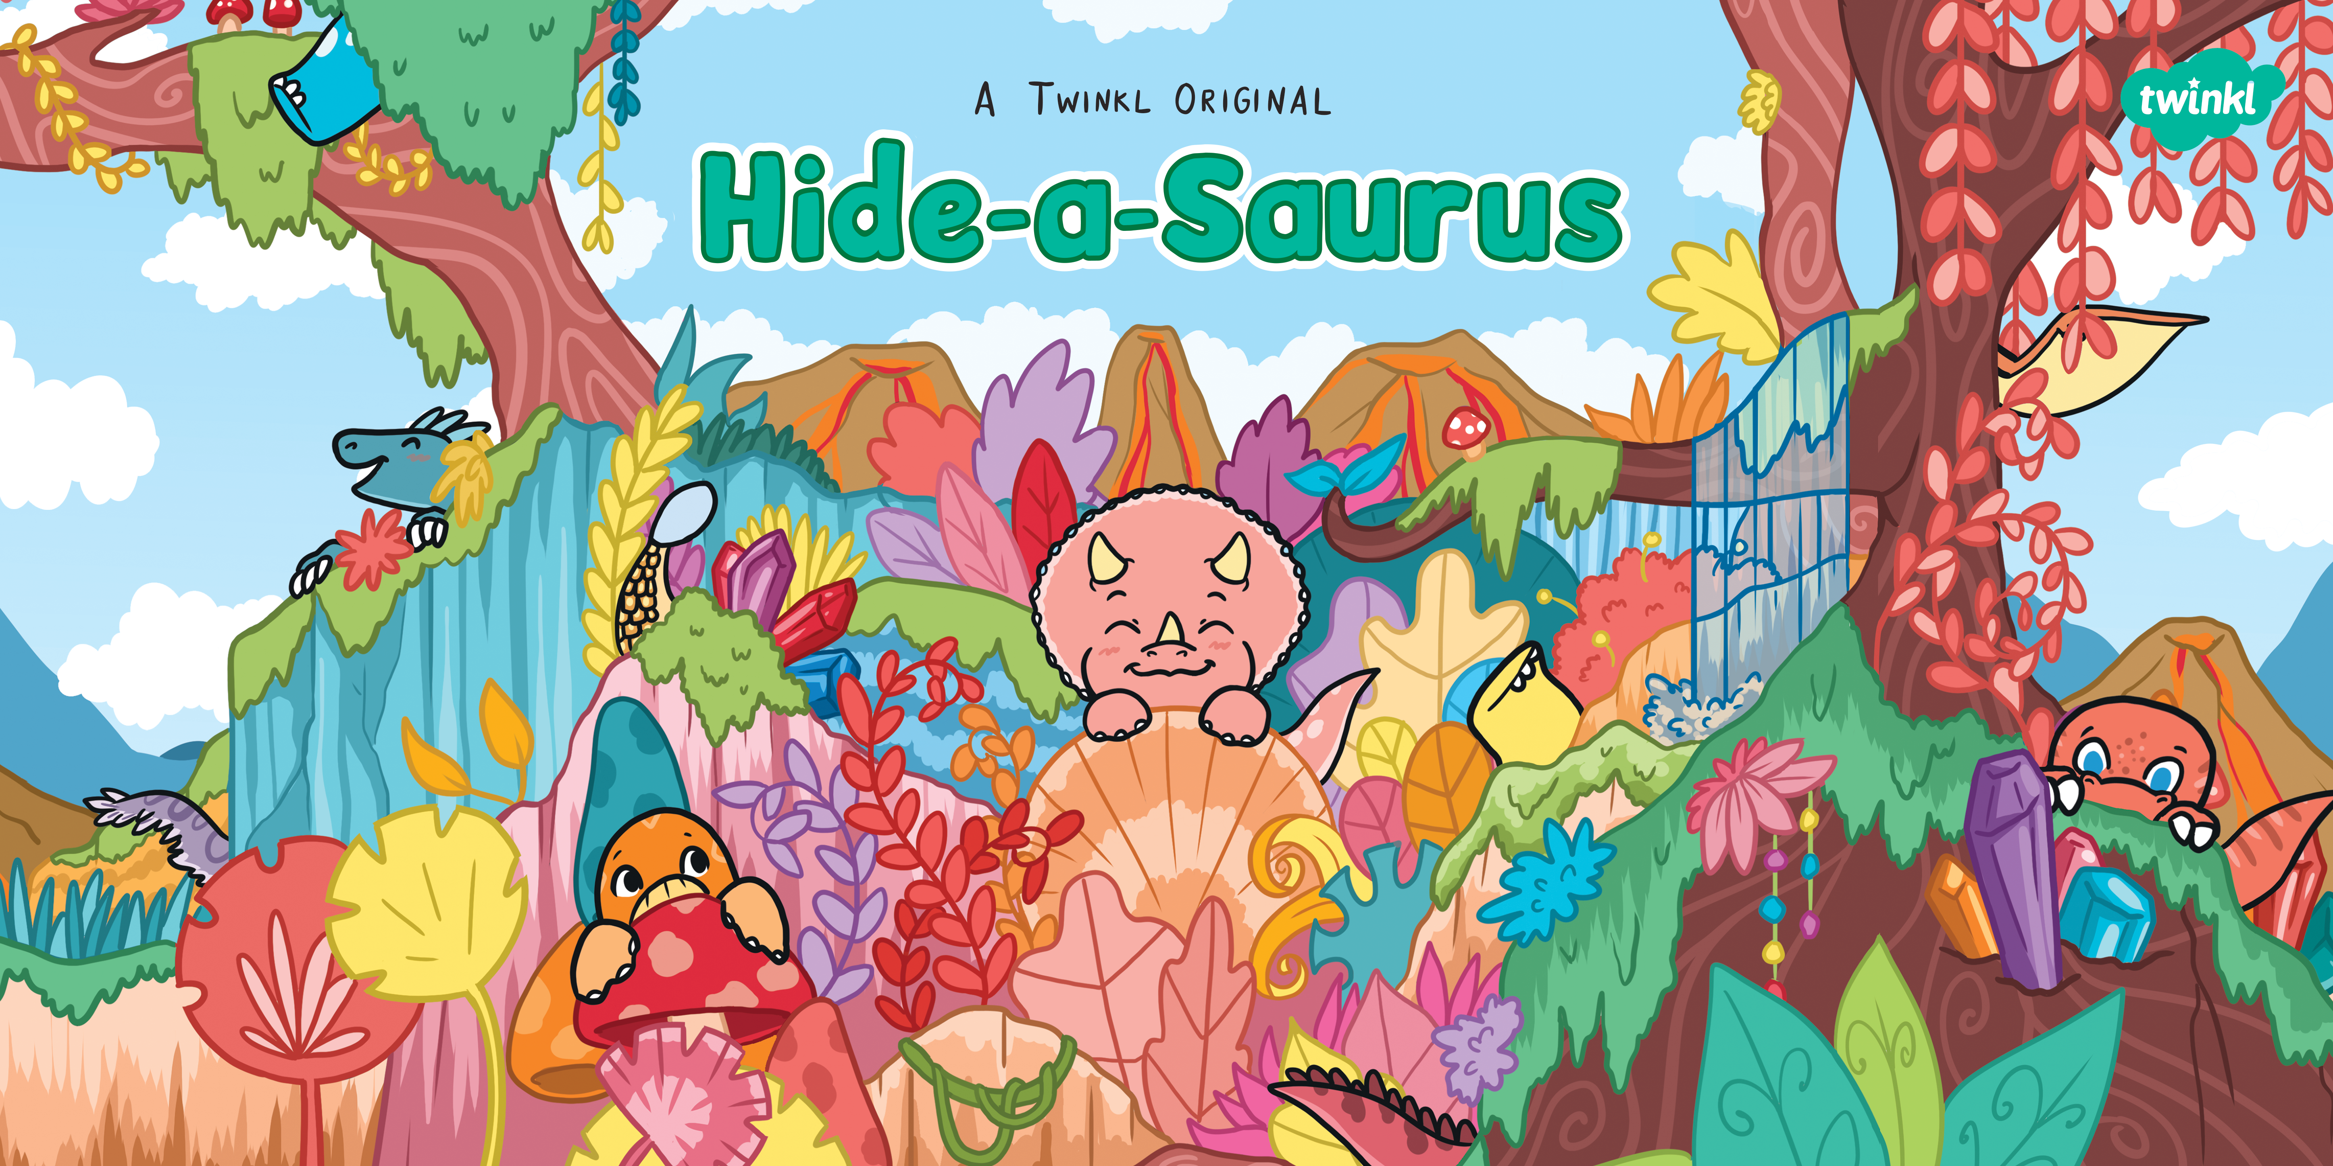

Slide 3
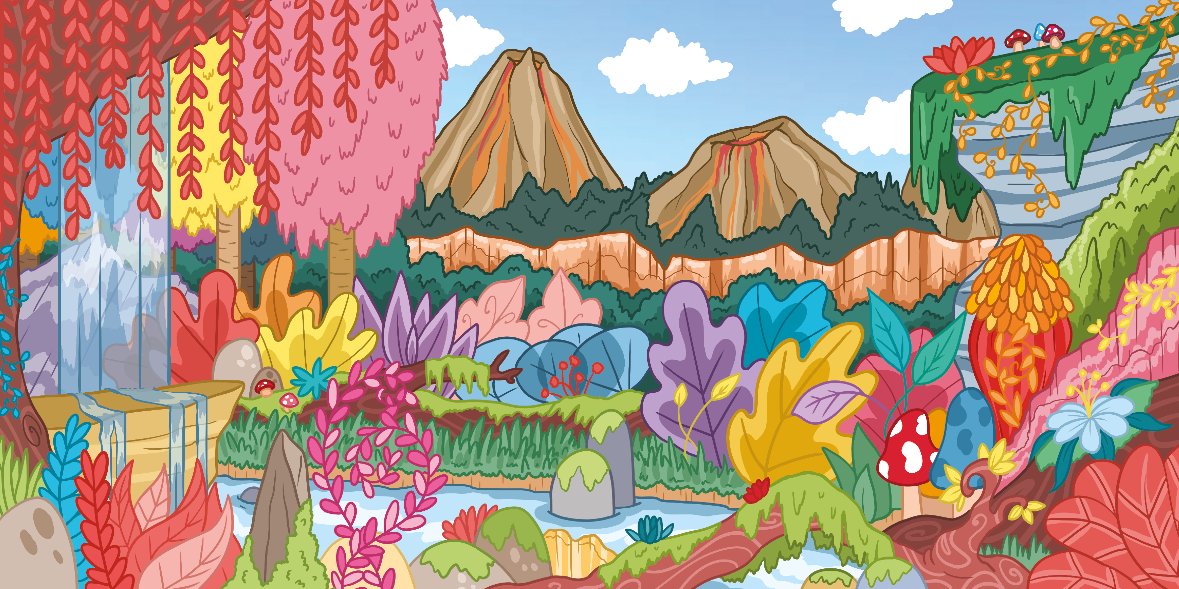

Slide 4
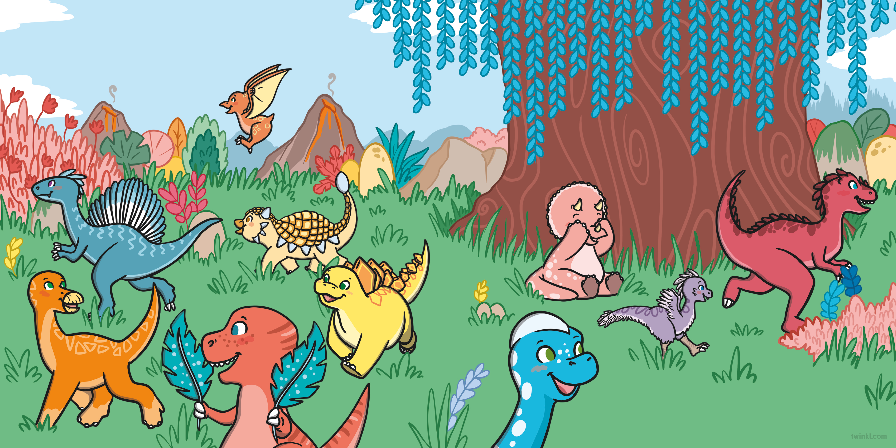
Triceratops and her friends are playing hide-and-seek.
She closes her eyes and starts to count...

Slide 5
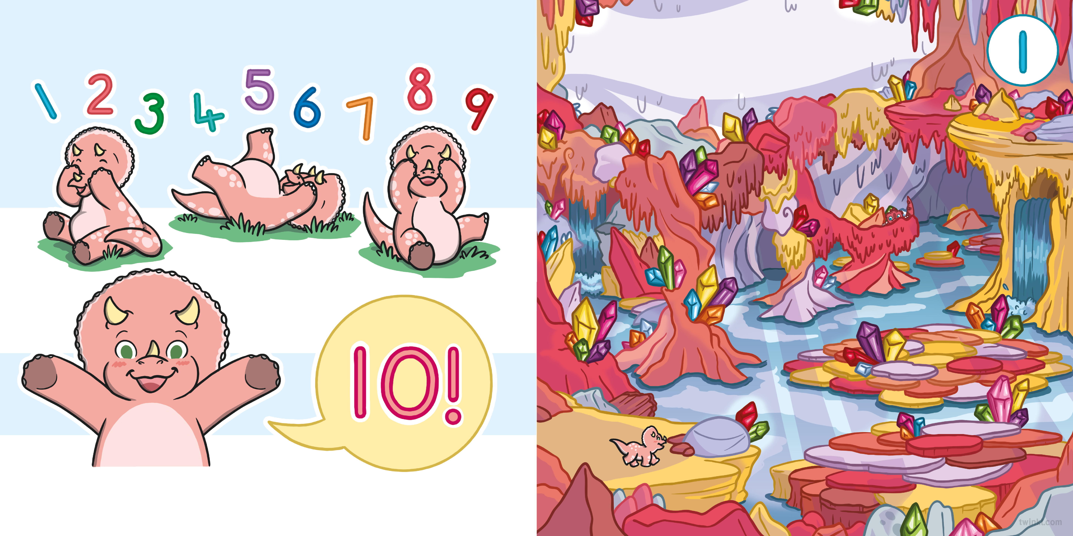
...all the way up to 10.
One excited dinosaur is creeping through the caves. Is anyone hiding here?
“Ready or not, here I come!” shouts Triceratops.

Slide 6
“Found you, Allosaurus!”
says Triceratops.
Two excited dinosaurs are tiptoeing towards the trees. Is anyone hiding here?
“Come and join the search!”

Slide 7
“Found you, Velociraptor!”
says Triceratops.
Three excited dinosaurs are climbing on the cliffs. Is anyone hiding here?
“Come and join the search!”

Slide 8
“Found you, Ankylosaurus!” says Triceratops.
Four excited dinosaurs are wandering
in the woods. Is anyone hiding here?
“Come and join the search!”

Slide 9
“Found you, Brachiosaurus!” says Triceratops.
Five excited dinosaurs are searching in the sea. Is anyone hiding here?
“Come and join the search!”

Slide 10
“Found you, Spinosaurus!” says Triceratops.
Six excited dinosaurs are venturing around the volcano. Is anyone hiding here?
“Come and join the search!”

Slide 11
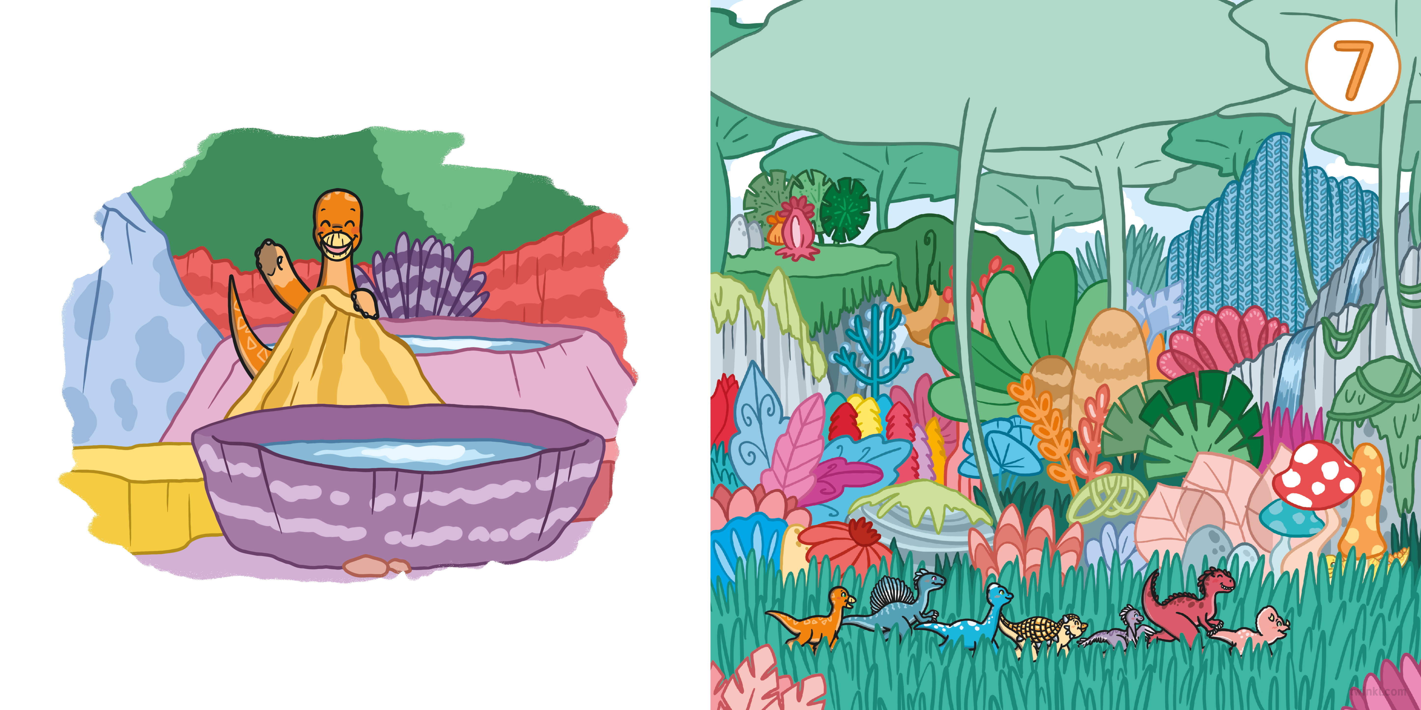
“Found you, Iguanodon!” says Triceratops.
Seven excited dinosaurs are peeking through the plants. Is anyone hiding here?
“Come and join the search!”

Slide 12
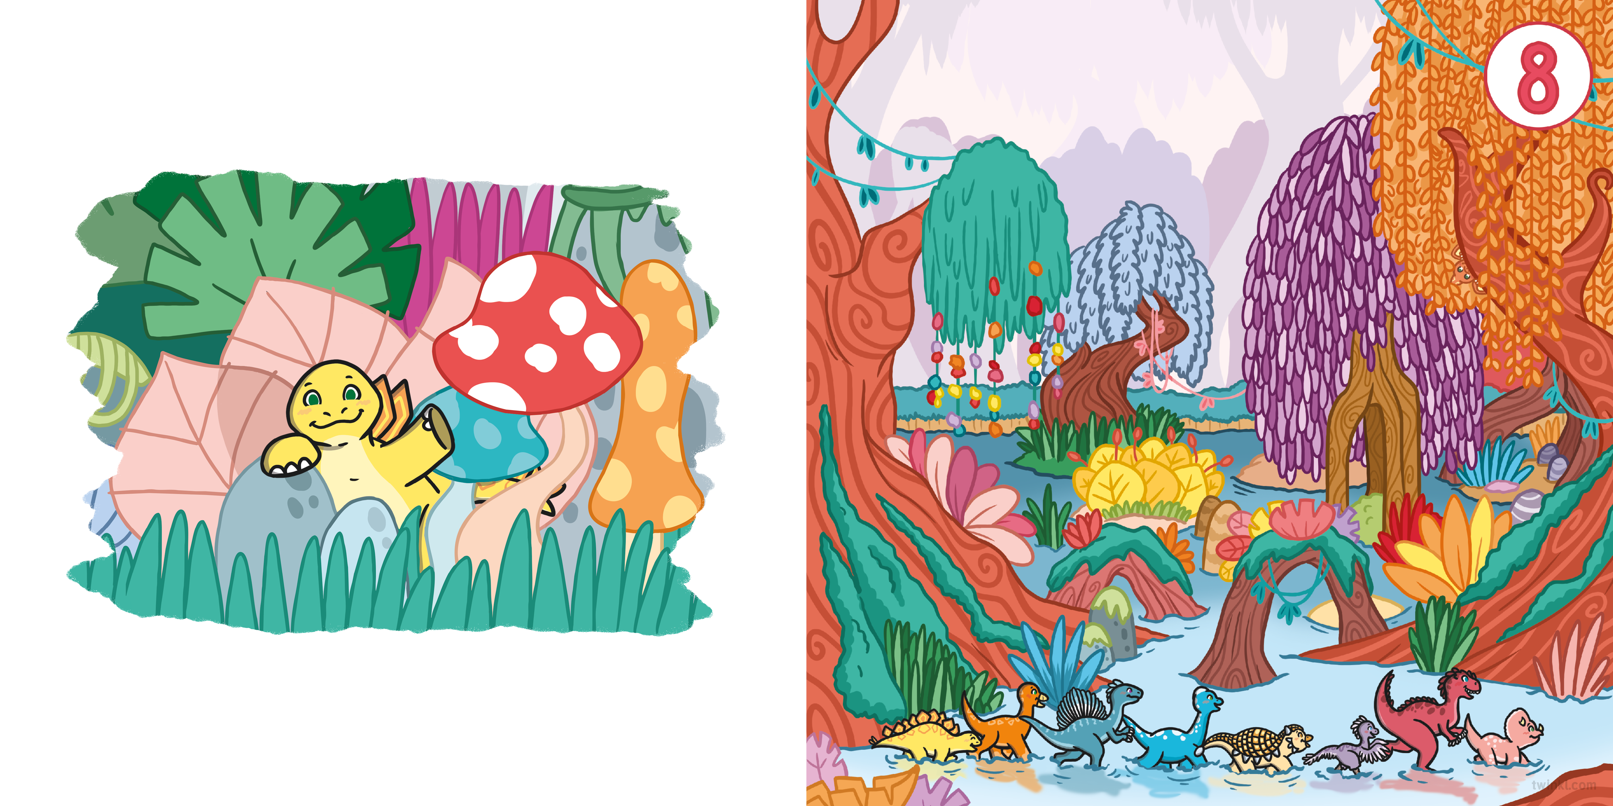
“Found you, Stegosaurus!” says Triceratops.
Eight excited dinosaurs are splashing
in the swamp. Is anyone hiding here?
“Come and join the search!”

Slide 13
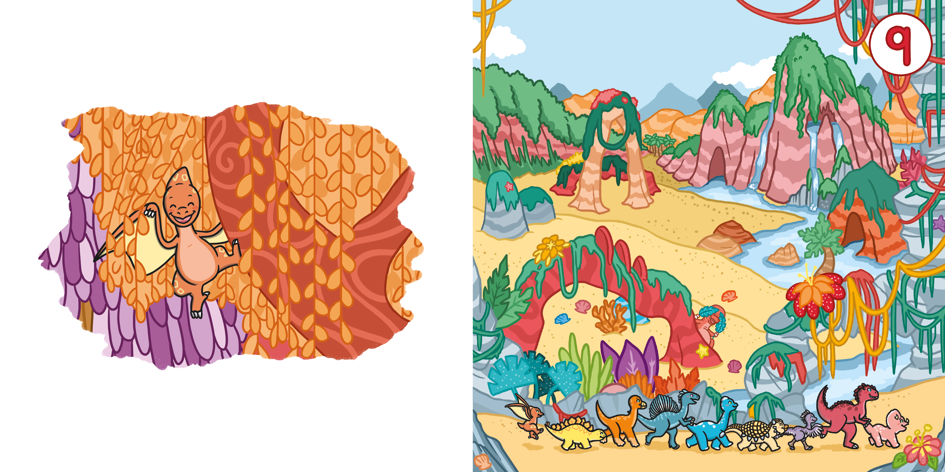
“Found you, Pterodactyl!” says Triceratops.
Nine excited dinosaurs are stomping
on the sand. Is anyone hiding here?
“Come and join the search!”

Slide 14
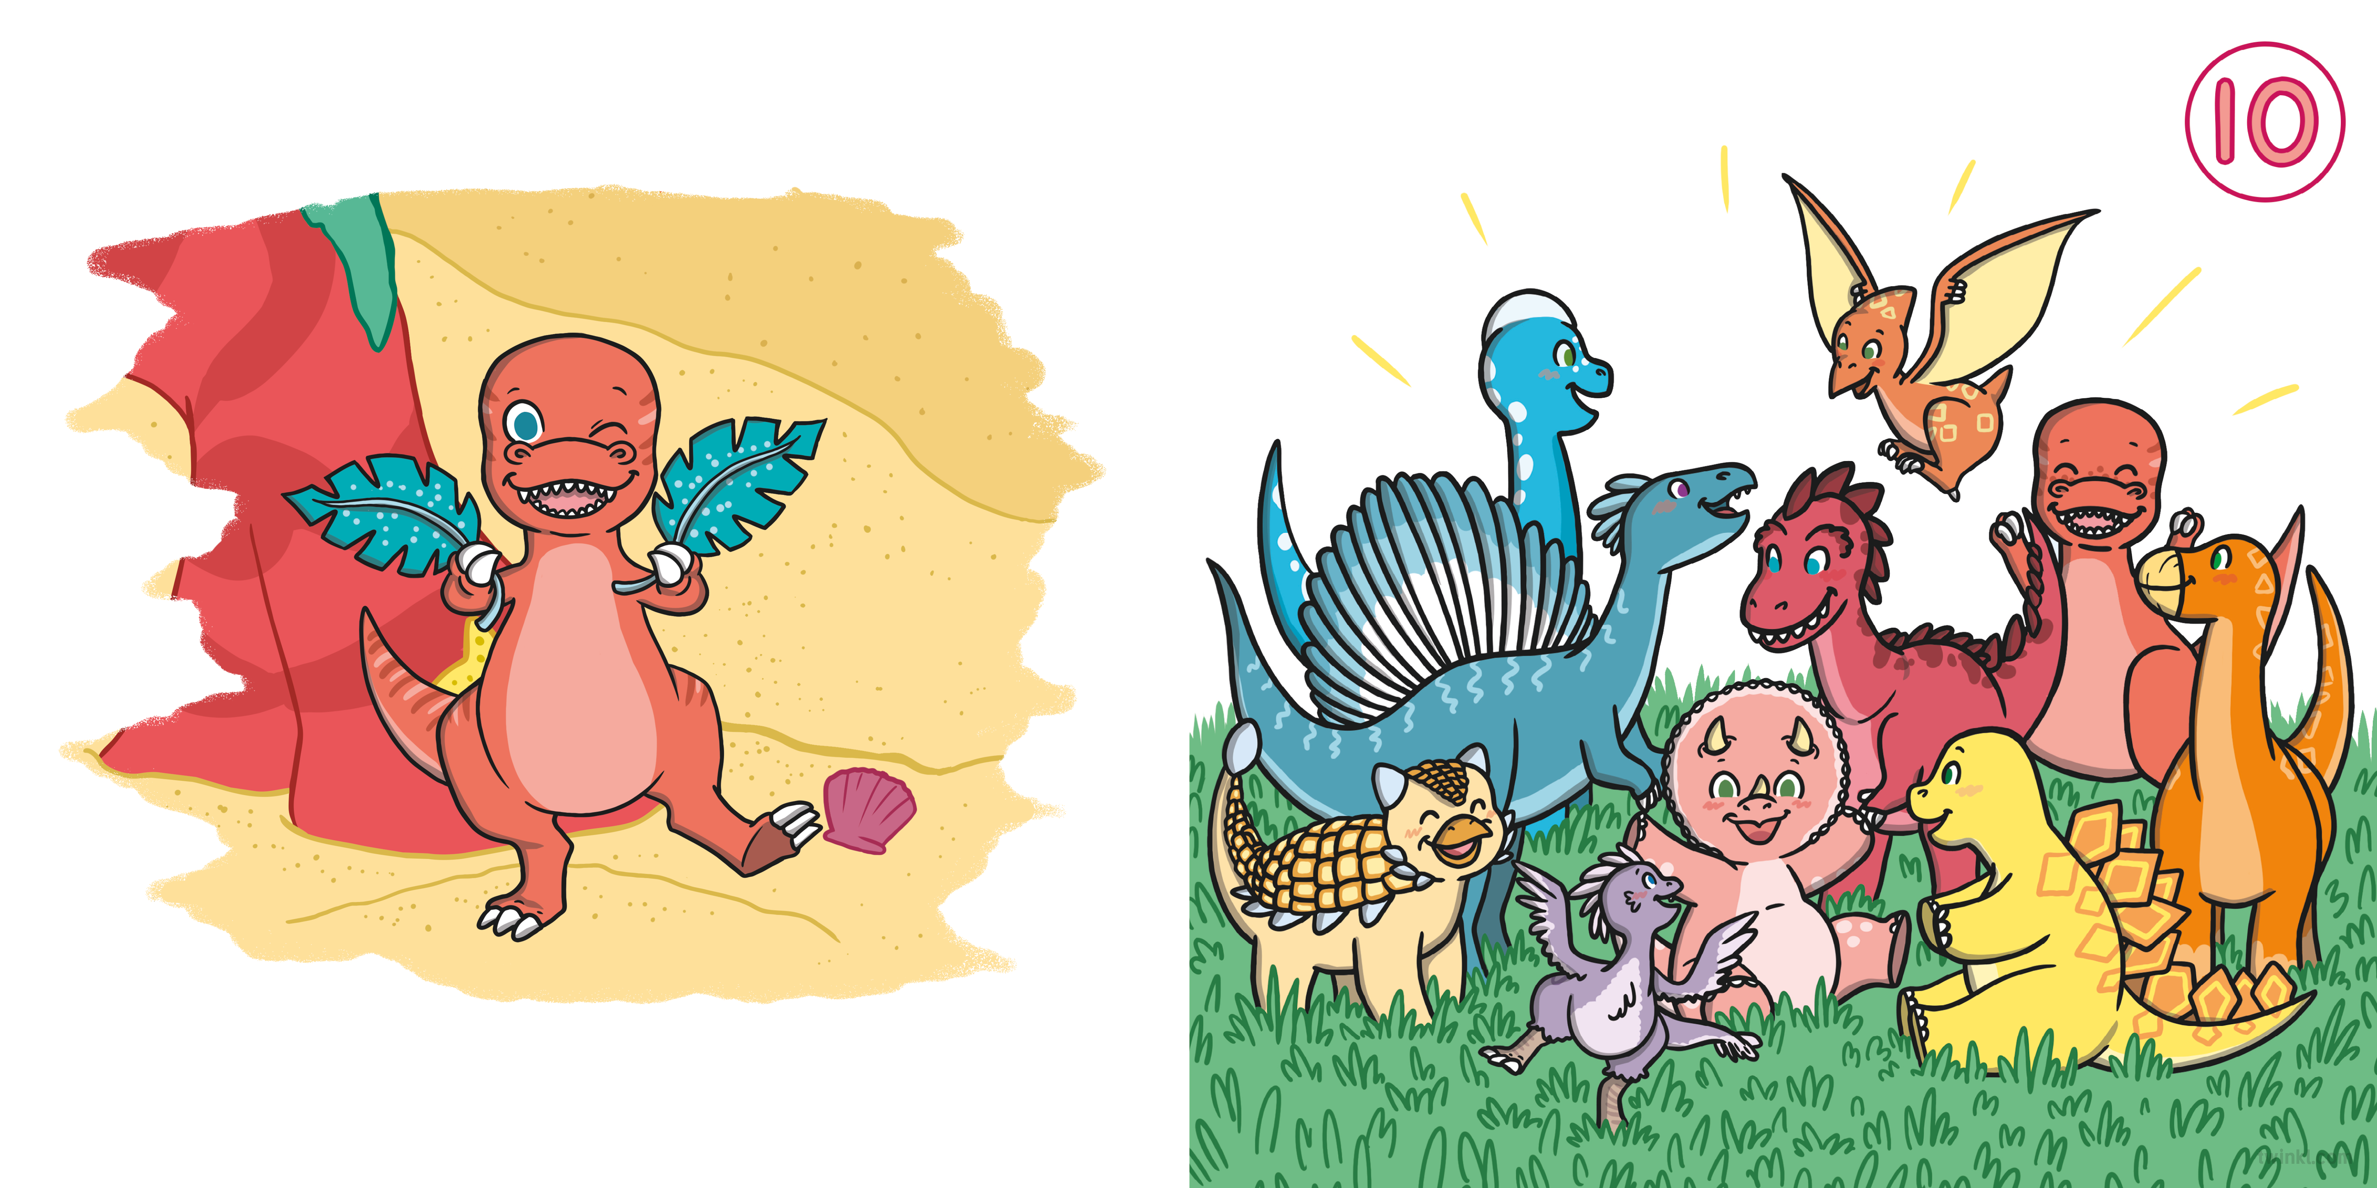
“Found you, Tyrannosaurus Rex!” says Triceratops.
Ten excited dinosaurs all want to play again!

Slide 15
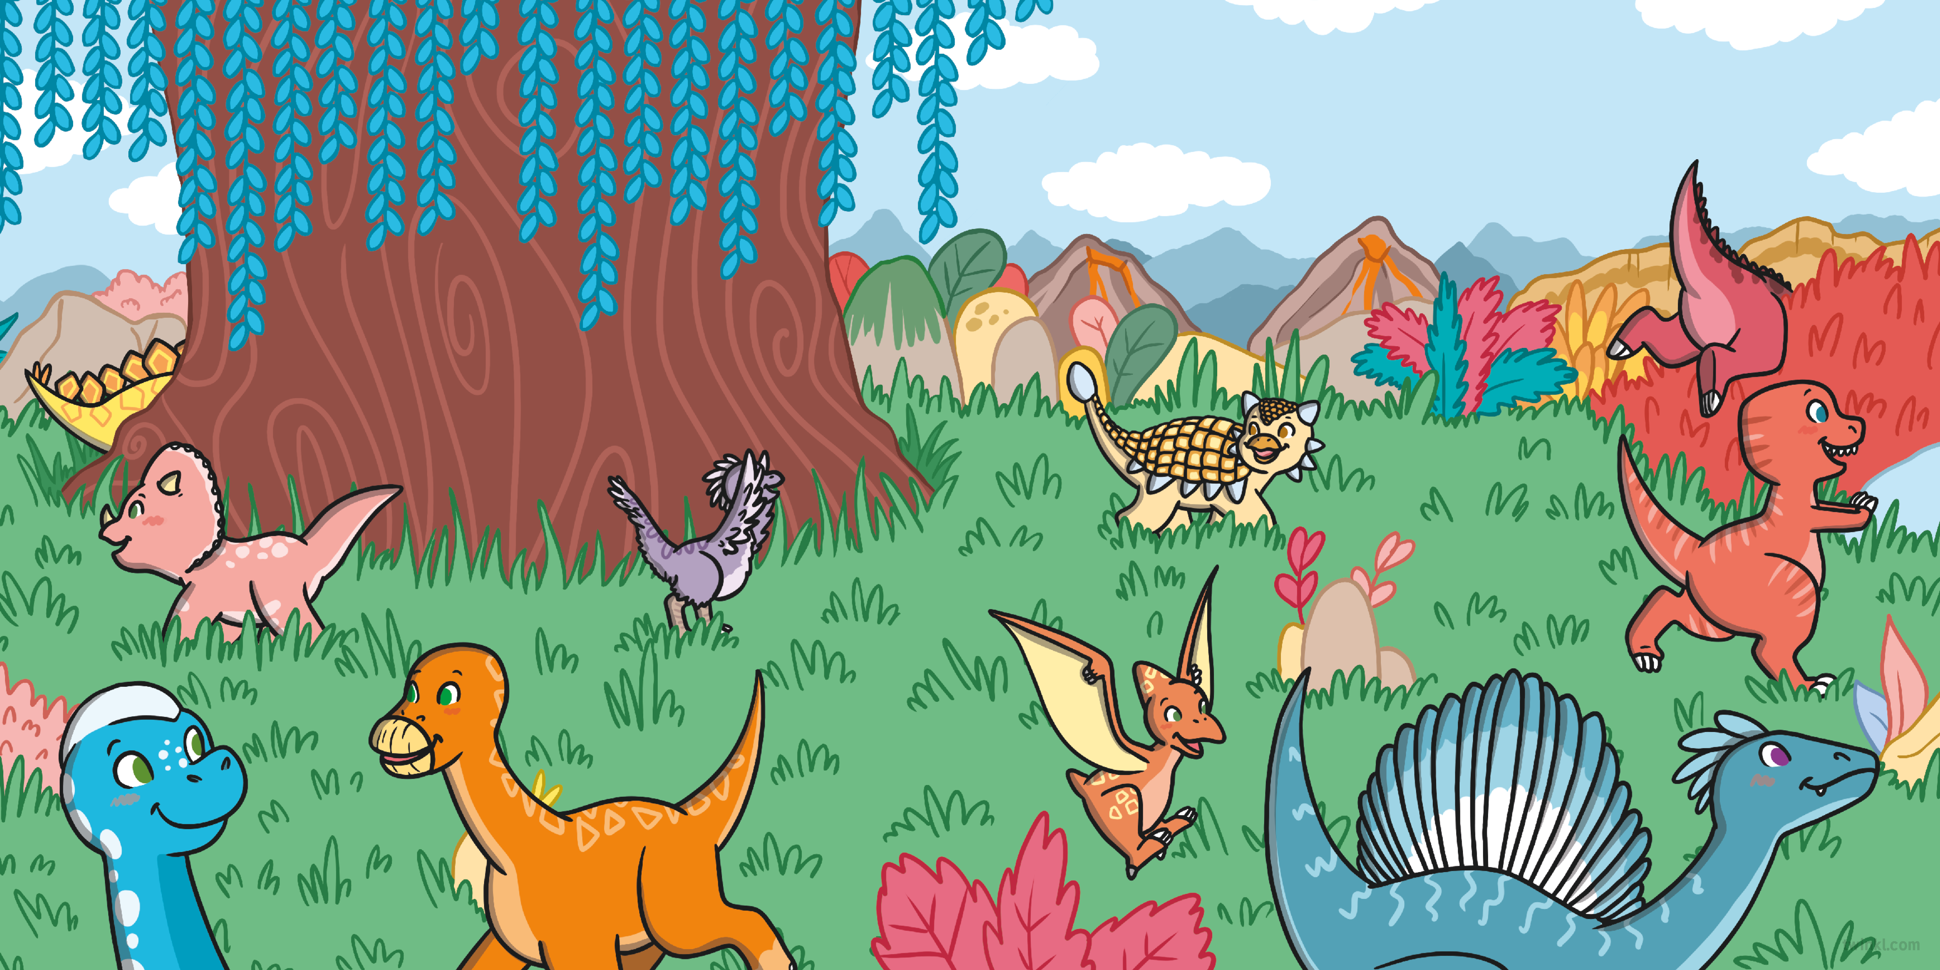
Whose turn is it to count this time?

Slide 16
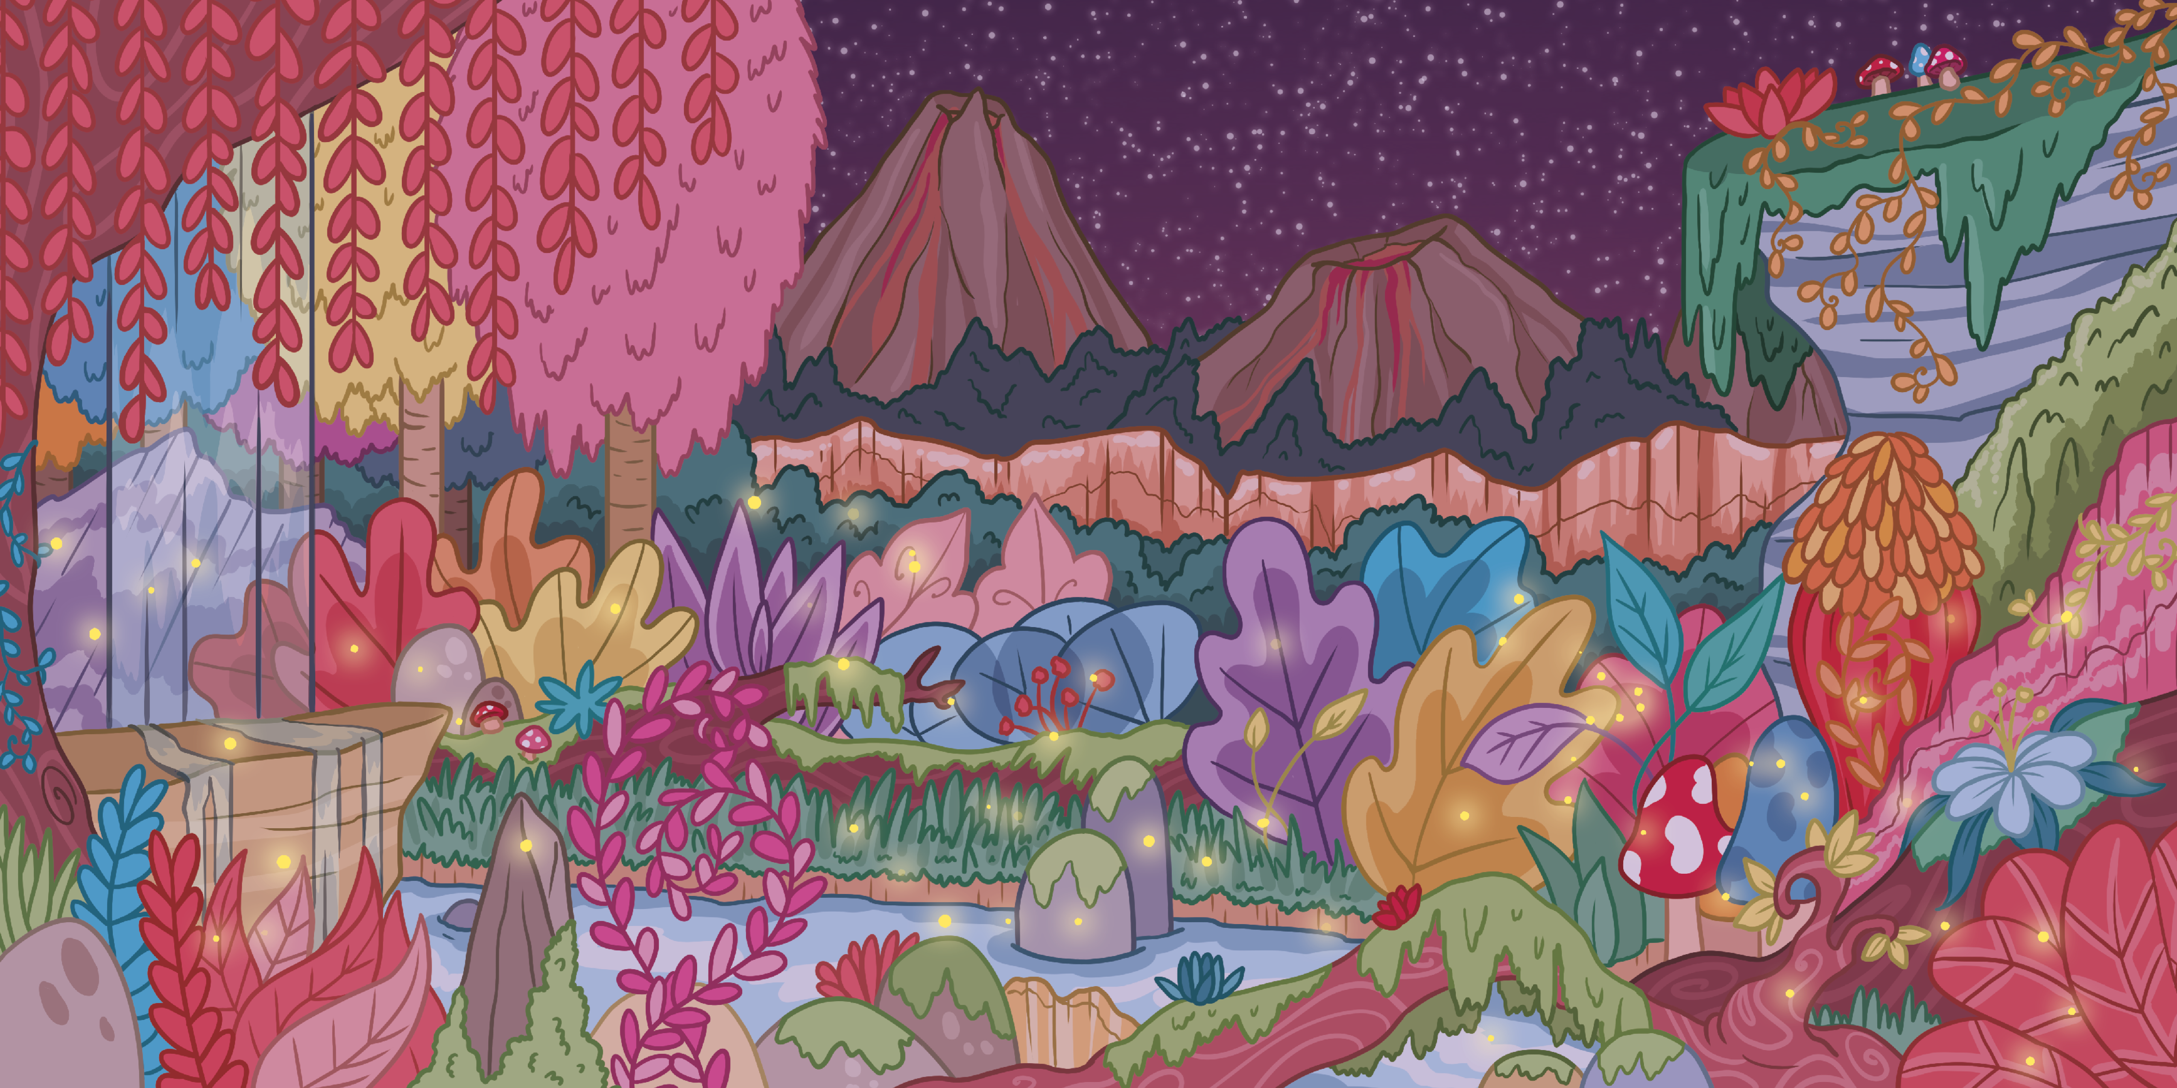

Slide 17
