Slide 1
Keeping Children Safe Online
NSPCC

Slide 2
Benefits of being online
Enables children to find and benefit from information and support which might otherwise be inaccessible.
Gives them a voice about issues which they care about.
Allows them to portray themselves in ways that are important to them.

Slide 3
How long do
8-11 year olds spend online per week?
13 hours and 36 minutes (Average)

Slide 4
Facts
58% of 3-4 year olds use a tablet
38% of 8-11 year olds own a smart phone
The increase in use of mobile devices brings new challenges as children can access the internet from anywhere.

Slide 5
What apps and programmes are children using?

Slide 6
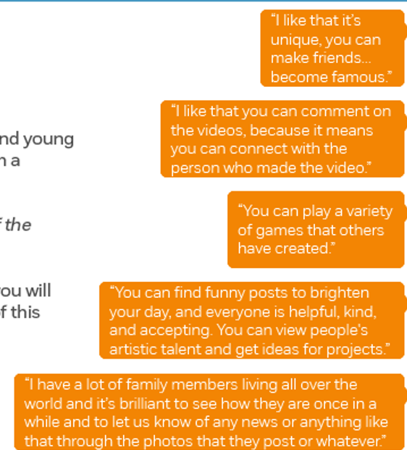
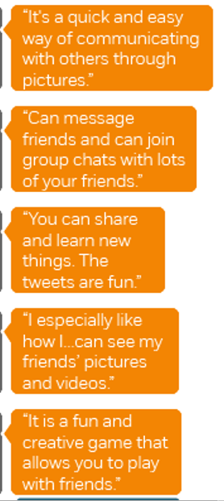
Minecraft
Tumblr
Tiktok
Snapchat
Facebook
Whatsapp
Twitter
Roblox
YouTube
Instagram

Slide 7
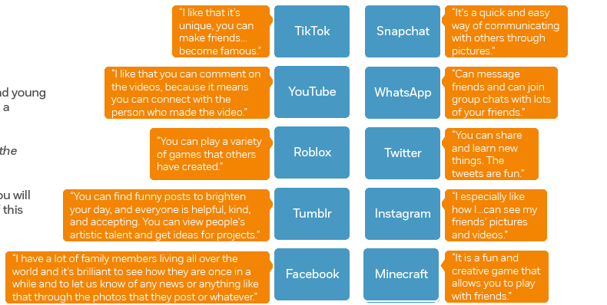

Slide 8
Net aware
Net Aware Website

Slide 9
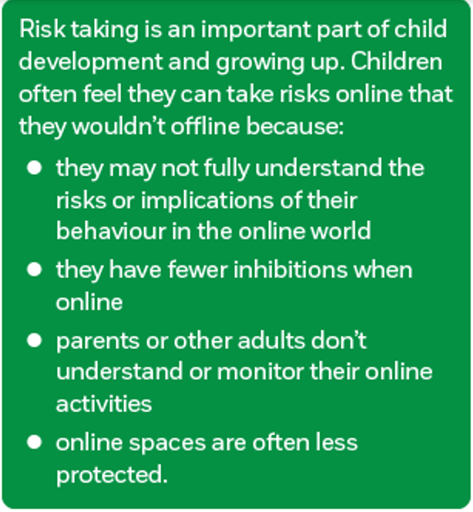
Children taking risks online

Slide 10
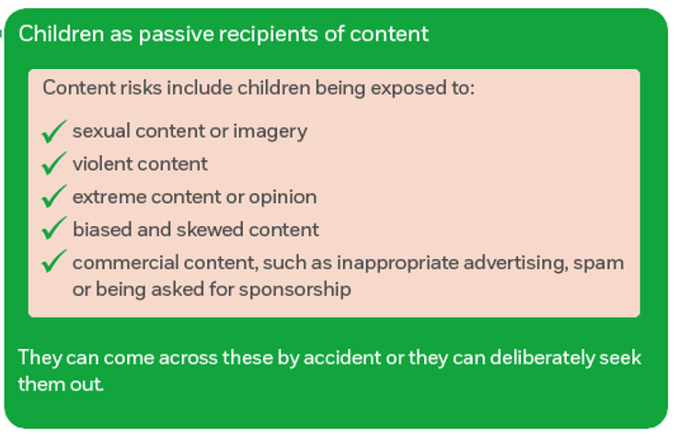
Risk Taking
The 3 C’s
Content
Contact
Conduct

Slide 11
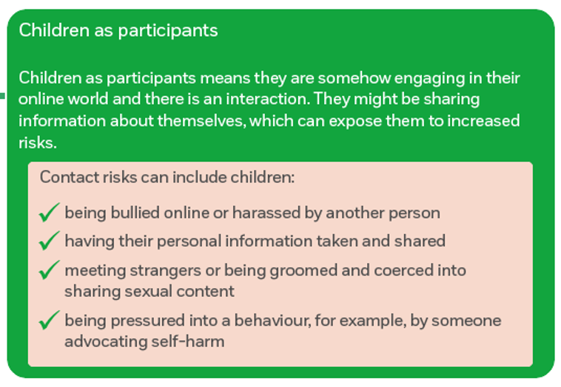
Risk Taking
The 3 C’s
Content
Contact
Conduct

Slide 12
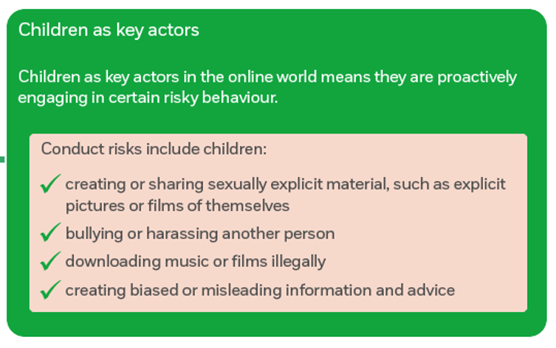
Risk Taking
The 3 C’s
Content
Contact
Conduct

Slide 13
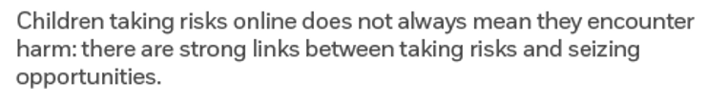
Risk Taking

Slide 14
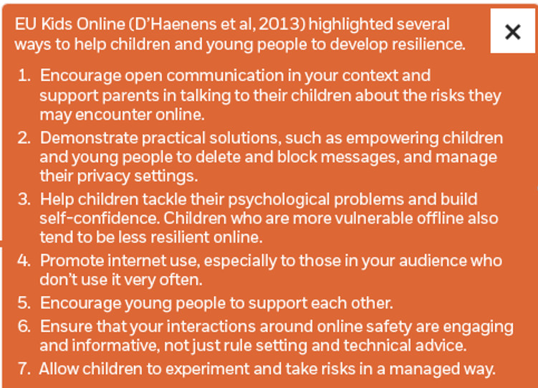
Developing Resilience

Slide 15
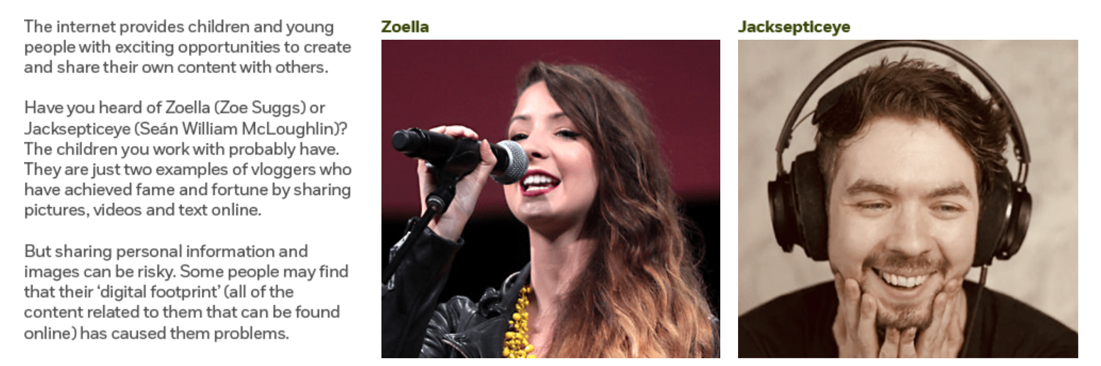
Sharing Personal Content

Slide 16
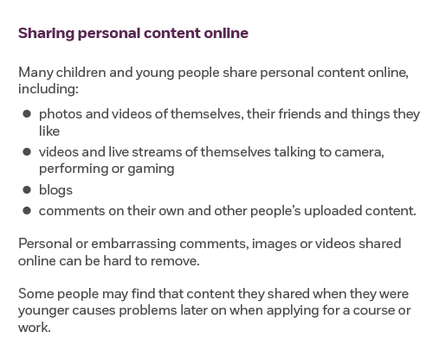
Sharing Personal Content

Slide 17
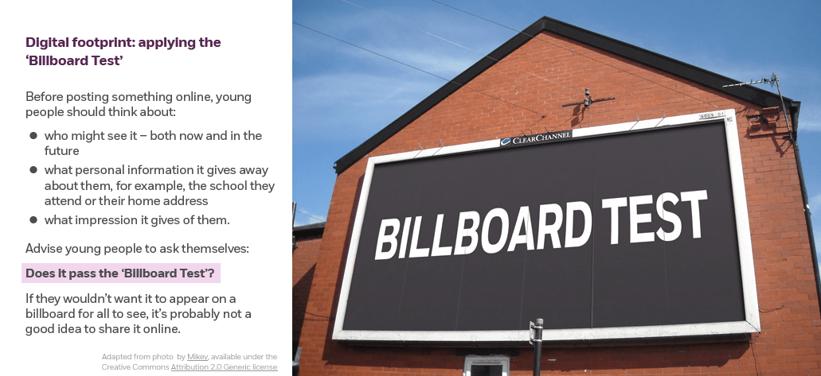

Slide 18
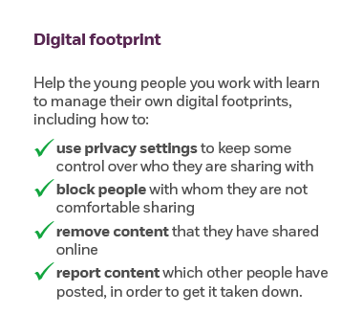
Digital Footprint

Slide 19
Sharing Personal Content
This video can promote discussion about sharing personal information
(1min 37sec)

Slide 20
Sexual offending against children online

Slide 21
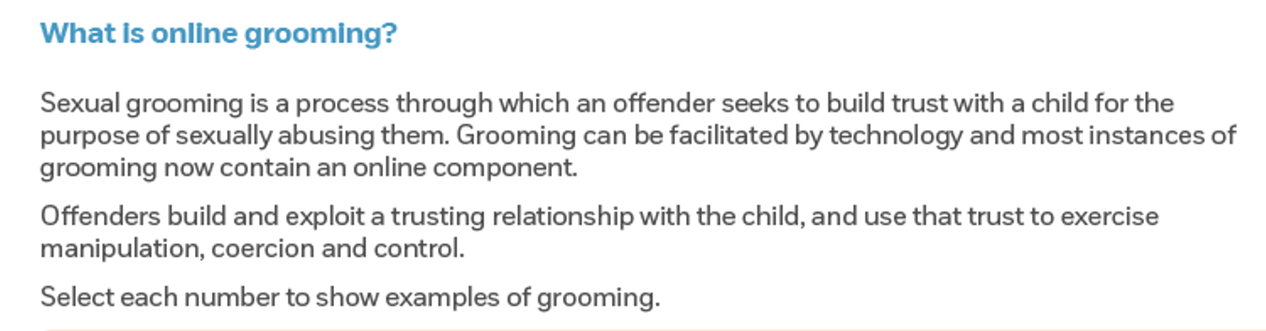
Danielle’s Story (3 min 16sec)

Slide 22
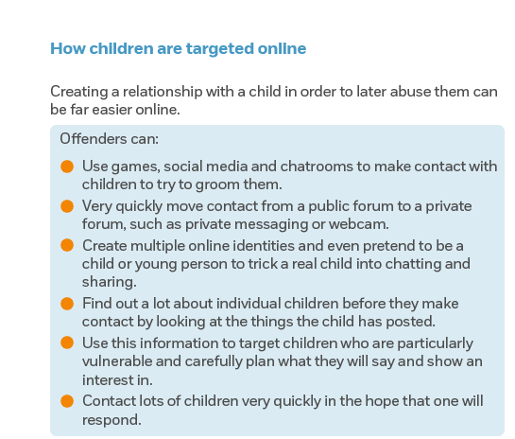
Sexual offending against children online

Slide 23
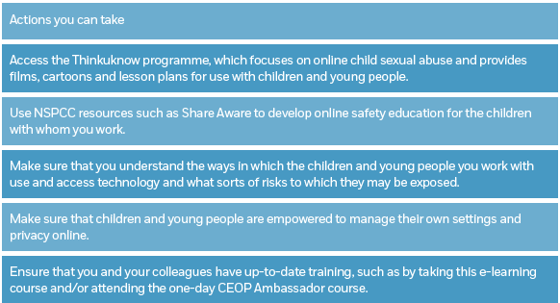

Slide 24
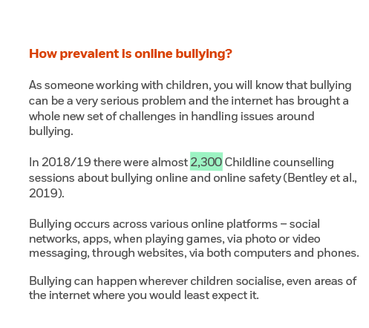
Online Bullying

Slide 25
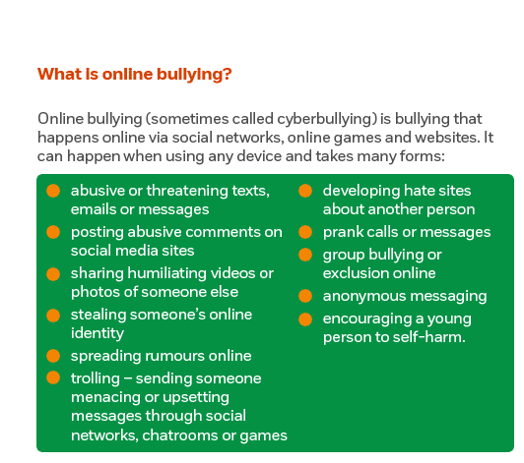

Slide 26
Online Bullying
Children speak about the impact of bullying (5 mins 38 sec)

Slide 27
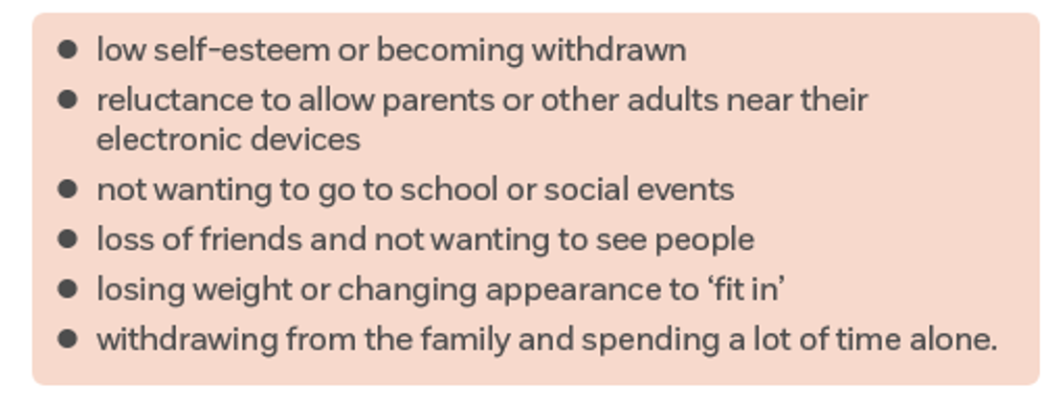
The effects and consequences of online bullying

Slide 28
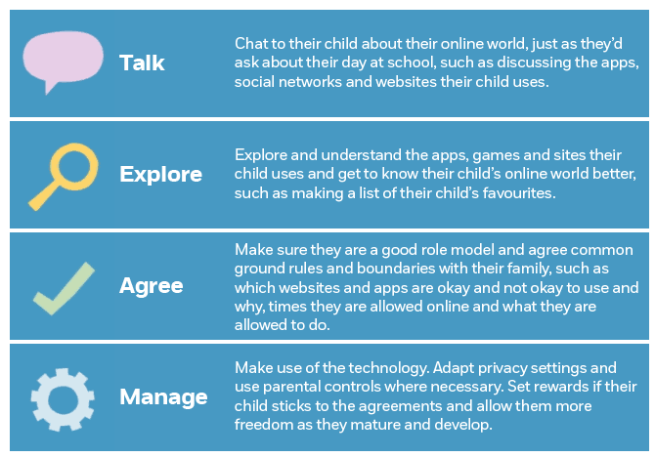
Tips for helping parents

Slide 29
Tips for helping parents
Information about keeping children safe
CEOP for parents and professionals
Parentinfo.org information and
news

Slide 30


Slide 31
Useful Websites
https://www.net-aware.org.uk/ (NSPCC)
https://www.thinkuknow.co.uk/professionals/resources/
https://www.childline.org.uk/info-advice/bullying-abuse-safety/online-mobile-safety/staying-safe-online/
Information and advice for children

